Slide 1
Our environment

Slide 2
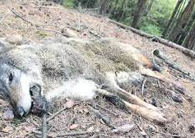
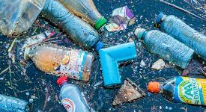
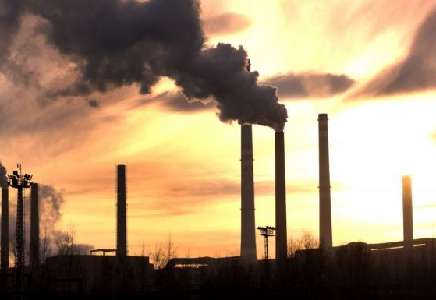
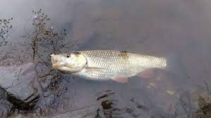
Our planet
We have to be responsible to save our planet and our environment. We must follow these rules, how to behave ecologically and ecenomically at home, at school and in a work to keep our planet healthy and clean.

Slide 3
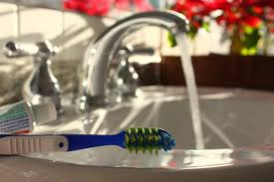
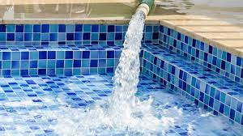
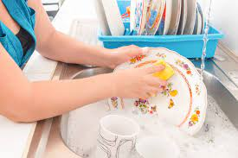
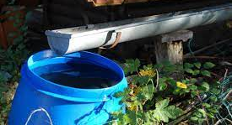
Water
We should save water when we are:
Washing our hands
Washing the dishes
Doing our hygiene- after the short shower
Filling a pool
Watering a garden

Slide 4
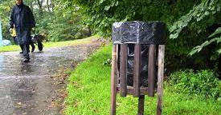
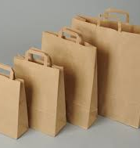
Recyclation
We have to recycle.
We should reuse paper bags, but we shouldn’t use plastic bags.
We should put the rubbish in the correct bin.

Slide 5
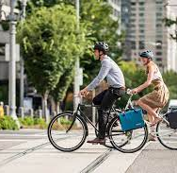
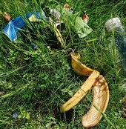
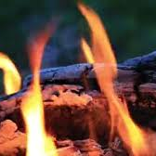
Nature
We shouldn’t leave rubbish in a nature.
We shouldn´t make fire in the forest.
We should use a bike more than a car or a bus.

Slide 6
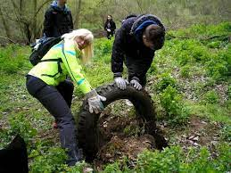
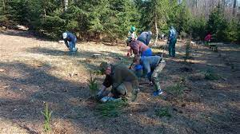
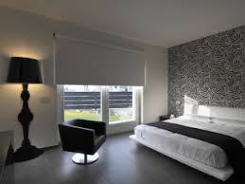
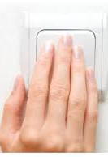
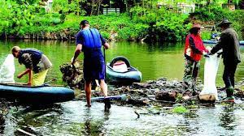
Another
We have to save electricity.
We should turn the lights off when we are not in the room.
We should help with cleaning forests and rivers.
We should plant trees.

Slide 7
If we don’t respect these rules, we will be dead because our planet is the only one which has water and carbon dioxide. Please help to save our planet.

